Slide 1
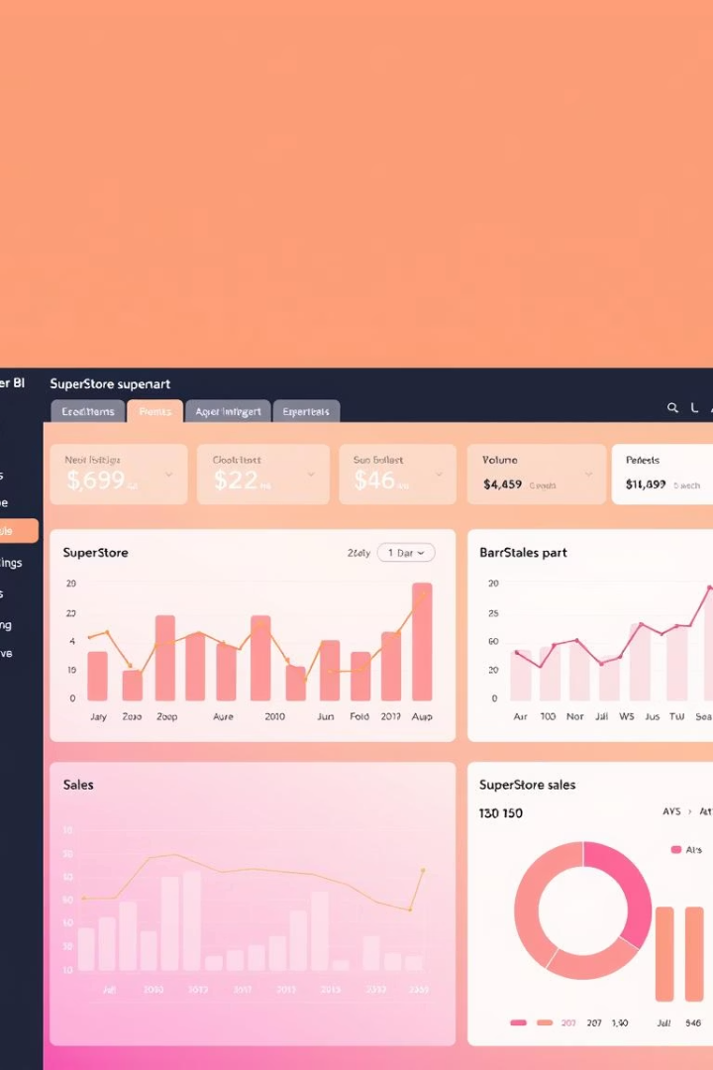

Sales Dashboard Design - SuperStore Dataset
Welcome to this presentation on designing an interactive sales dashboard using Power BI. This project leverages the SuperStore dataset to provide critical insights for business stakeholders, enhancing decision-making through dynamic visualizations and key performance indicators.
by K.S. Sushanth

Slide 2




Project Objective
Interactive Dashboard
Visualize KPIs
Sales, Profit, Profit Margin
Build for business stakeholders
Enable Business Decisions
Through time-series, filters, drilldowns

Slide 3

Dataset: SuperStore Sales Data
Source
Kaggle (SuperStore)
Time Range
2014-2017
Records
9,994 records
Key Columns
Sales, Profit, Discount, Region, Category, Order Date

Slide 4
Key Dashboard Features
KPIs Displayed
Interactive Filters
Visual Types
Interactivity
Total Sales
Region
Cards
Slicers
Total Profit
Segment
Bar Charts
Drillthrough
Profit Margin (%)
Category
Line Charts
Color-coded consistency
Time

Slide 5
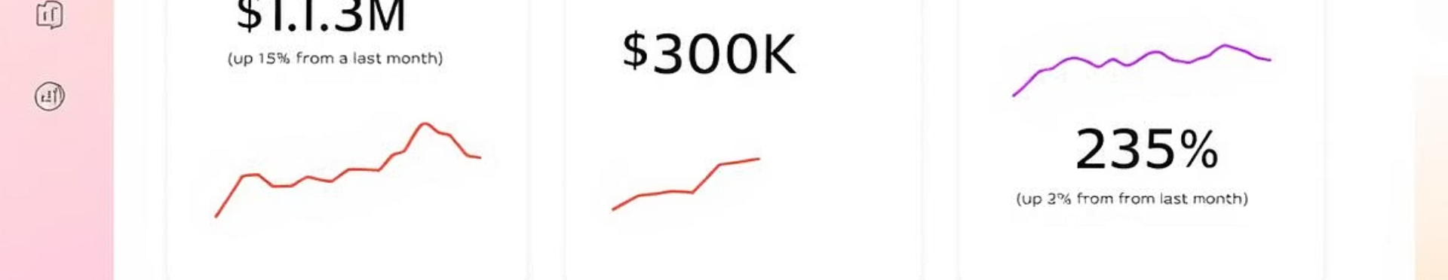
KPI Cards - Key Metrics
$2.3M
$286K
12.4%
Total Sales
Total Profit
Profit Margin
Overall revenue generated
Net earnings
Profitability percentage
A line chart showing Yearly Sales Trend is also included to provide historical context and highlight growth patterns.

Slide 6
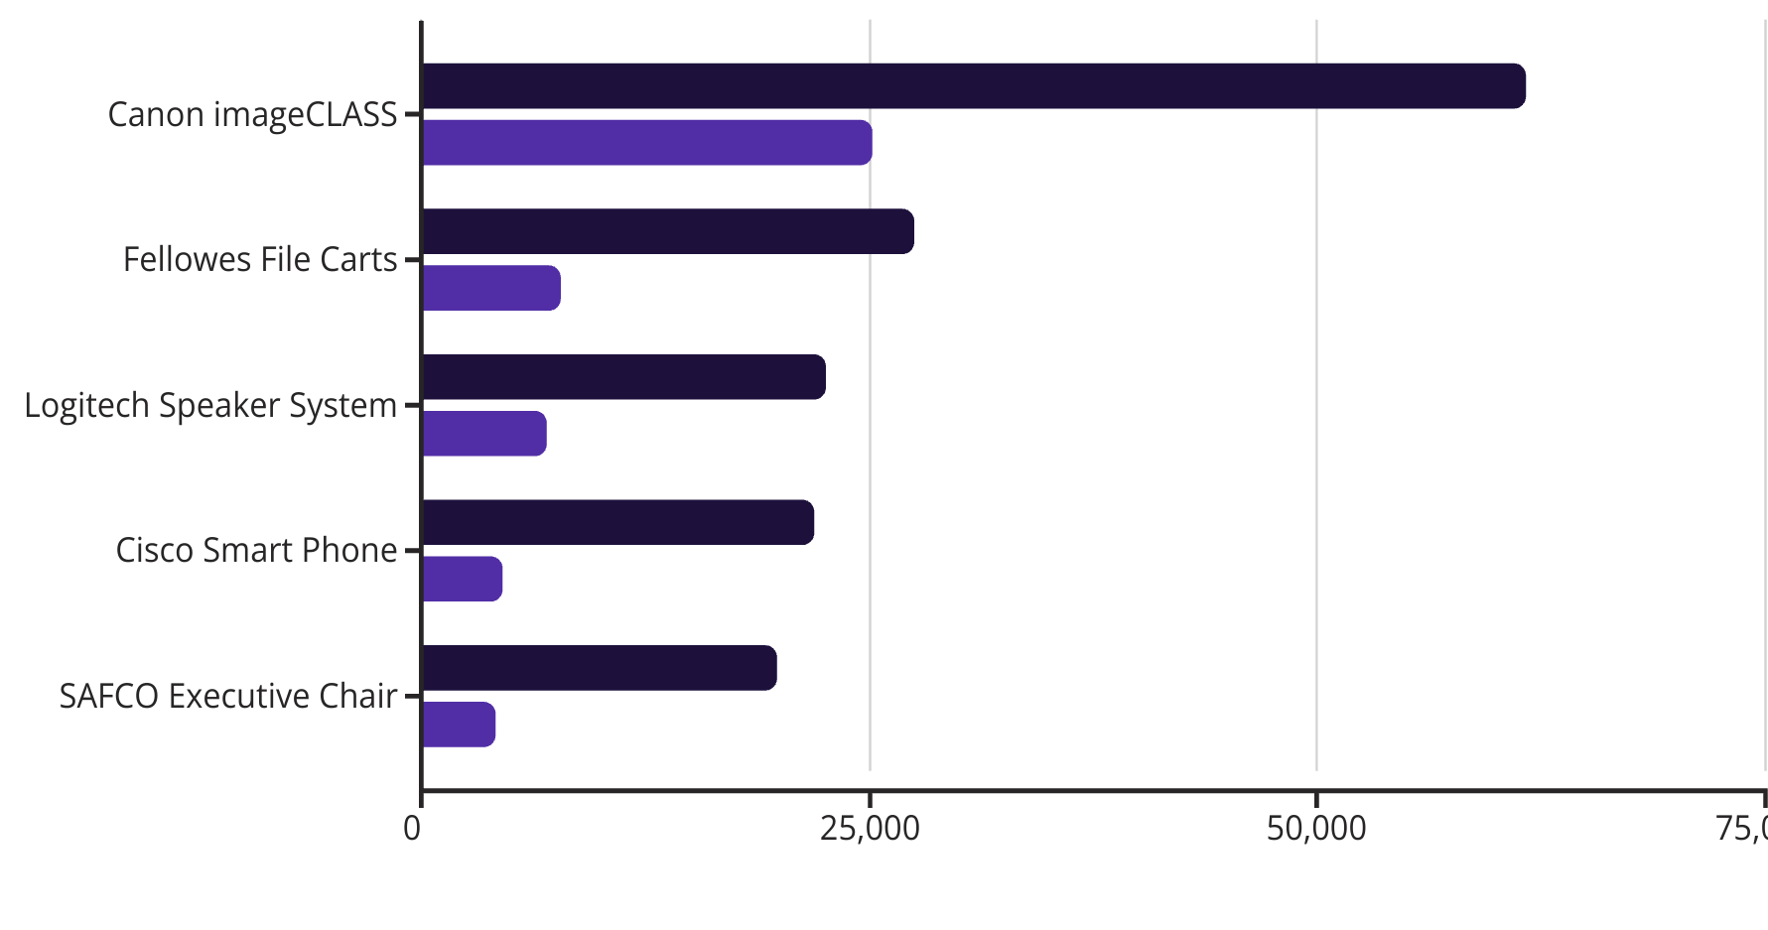
Top Performing Products
Sales
Profit
This chart quickly identifies top revenue generators and their corresponding profitability. Optionally, a "Top Customers" visual could be added to highlight key accounts.

Slide 7
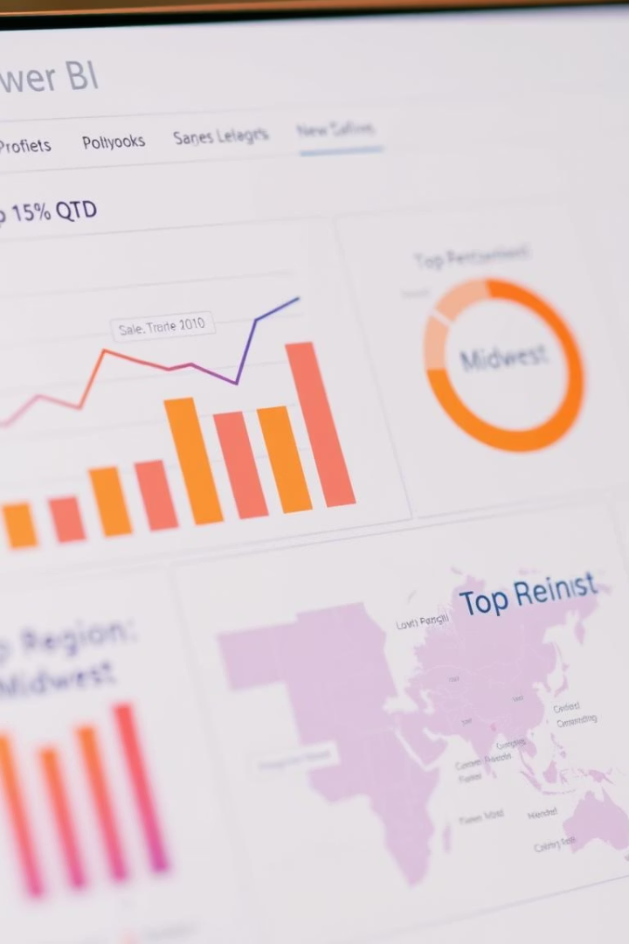



Key Business Insights
Regional Performance
East region generated highest revenue
South region showed highest profit margin
Category Profitability
Furniture: high sales, lower profit margins
Due to higher discounts applied
Year-over-Year Growth
Profitability improved YoY
Despite stable overall sales

Slide 8








Interactivity & Navigation
Page Navigation
Consistent Colors
Via buttons and bookmarks
Sales = Blue, Profit = Green
Intuitive Slicers
Dynamic Titles
For quick data filtering
Based on slicer selections

Slide 9

Learnings & Outcome
Business Strategy Impact
Hands-on DAX & Slicers
Stakeholder-Focused Design
Improved Power BI Skills
Understood dashboard role
Practical application of measures
Learned to prioritize user needs
Enhanced dashboarding capabilities

Slide 10

Thank You!
This project has been an invaluable experience in translating raw data into actionable business intelligence. I am confident these skills will continue to drive effective data-driven decisions.

